Slide 1

[Samsung PRISM] End Review Report
Develop a Quality Assurance framework for Image Generation Models
Working Team Details :
College Professor(s): Dr. Antony Louis Piriyakumar, Prof Geetha R
Students:
Ayush Kumar Singh / ayushkumar.20aiml@cambridge.edu.in
Akash V / akash.20aiml@cambridge.edu.in
Girish Chandra Saxena / chandrasaxena.20aiml@cambridge.edu.in
P Aaditya / padditiya.20aiml@cambridge.edu.in
Department: AIML
Date: 10 Jun 2024

Slide 2


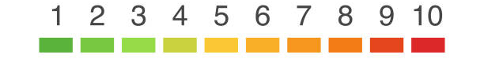

Develop a Quality Assurance framework for Image Generation Models
Problem Statement
Expectations
Context
Undertaken Tasks
Develop a comprehensive framework for conducting equitable and standardized comparisons of image generation models, ensuring 'apple-to-apple' assessments. This framework should establish consistent evaluation metrics, benchmark datasets, and evaluation protocols to facilitate a fair and meaningful comparison of various image generation techniques. The goal is to advance the field of computer vision by providing a reliable means of model assessment and selection.
Exhaustive Literature Survey of Image Generation Metrics [CLIP, FID, SFS, CHAIR & etc]
Develop a fixed framework for Quality Assurance & Identify SOTA Benchmark Levels
Statement
Currently Image Generation Models’ QA is mainly subjective in Nature, Building a Framework consisting of SOTA metrics will enable easier comparison of Image Generation Models
KPI
Framework should consider all possibilities & parameters of the Image Generation Space
Worklet Details
Pranal Prasad Dongare
+91-7022250561
pranal.p@samsung.com
2
6
Timeline
Tushar Madaan
+91-9205301569
tushar.m2@samsung.com
Kick Off < 1st Month >
Milestone 1 < 2nd Month >
Duration (Months)
Members Count
Mentors
Problem Briefing
Check Feasibility
R&D on Image Generation Metrics
Identify a framework which accurately evaluates Image Generation Models
Pre-Requisite
Familiar with Coding predominantly Python
Familiar with Diffusion Models & Evaluation Metrics
Complexity
Notes:
https://nv-tlabs.github.io/DIB-R/

Slide 3
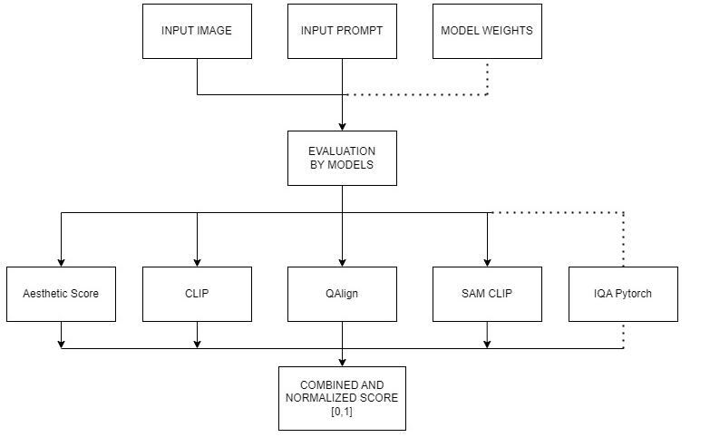
Approach / Solution
Concept Diagram :
( Clear detailed schematic / block diagram / flow chart depicting the proposed concept / solution )

Slide 4
Dataset(s) Analysis / Description
Dataset Capture / Preparation / Generation :
(Discuss the dataset generation process or if downloaded data provide details of what data & from where it was obtained etc… - 2 to 3 bullets only)
DiffusionDB dataset on Hugging Face containing 14 million images generated by Stable Diffusion, alongside their corresponding text prompts.
Downloaded from huggingface.
Link : Here
Dataset Understanding / Analysis :
(Provide 2 to 3 bullets about what is your understanding of the data / opinion about the data)
The dataset is tagged with keywords like "stable diffusion," "prompt engineering," and "research paper,"
DiffusionDB provides two subsets (DiffusionDB 2M and DiffusionDB Large)
Images in DiffusionDB 2M are stored in png format; images in DiffusionDB Large use a lossless webp format.
Dataset Pre-Processing / Related Challenges (if any) :
(List out the challenges you fore see in data handling wrt problem definition – 2 to 3 bullets only)
No open source human evaluated dataset was found

Slide 5
Experimental Results / Simulations / Observations
Results :
(provide numerical data / bar charts / plots / images / videos / tabulated results etc. Use full slide or multiple slides up to max 3 slides to demonstrate the results)
A csv file has been uploaded on github of the results
Major Observations / Conclusions & Challenges :
(provide details about your findings, experimental opinion – Use separate slide if necessary)
The lack of availability of an open-source human evaluated dataset
Most Metrics that was read about do not have appropriate implementations

Slide 6
Deliverable
Final Deliverables :
(Discuss in the form of bullets, what are the next steps to complete the solution, any road blocks / bottlenecks, any support needed from SRIB)
Different metrics have been implemented
Proper Framework has been created
IP / Paper Publication Plan :
(Details of papers / patentable ideas / innovative aspects that can lead to patentable ideas)
KPIs delivered/Expectations Met:
(Planned Expectations shared in Work-let vs Delivered Results)
Framework and metrics have been integrated and completed

Slide 7
Work-let Closure Details
Code Upload details:
Items | Details
KLOC (Number OF Lines of codes in 000’s)
Model and Algorithm details | Uploaded on GitHub
Is Mid review, end review report uploaded on Git ? | Yes
Link for Git | GitHub
Data details (if applicable):
Items | Data folder 1 | Data folder 2 | Data Folder 3……..
Name & Type of Data (Audio/Image/Video) | NA | NA | NA
Number of data points | NA | NA | NA
Source of Data (self collected, Scrapped, available on open source) | NA | NA | NA
Google drive link/ git link to access data | NA | NA | NA
Note: If data uploaded on google drive, access to be shared to prism.srib@gmail.com

Slide 9
Thank you

